Slide 1
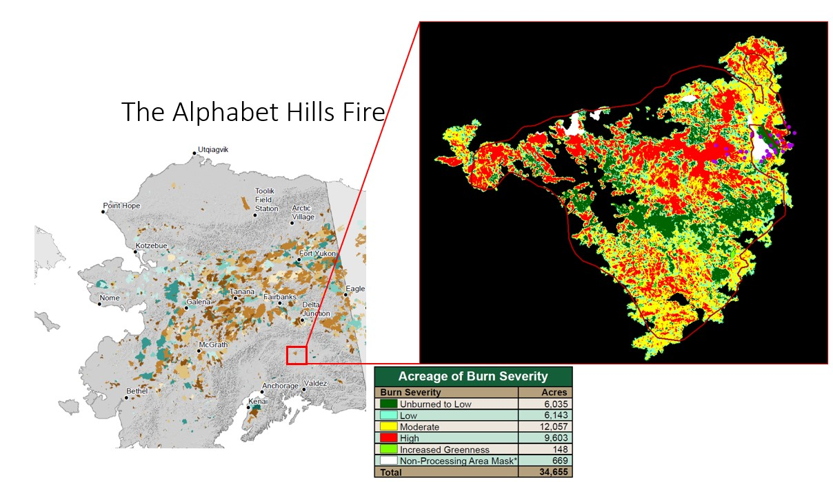
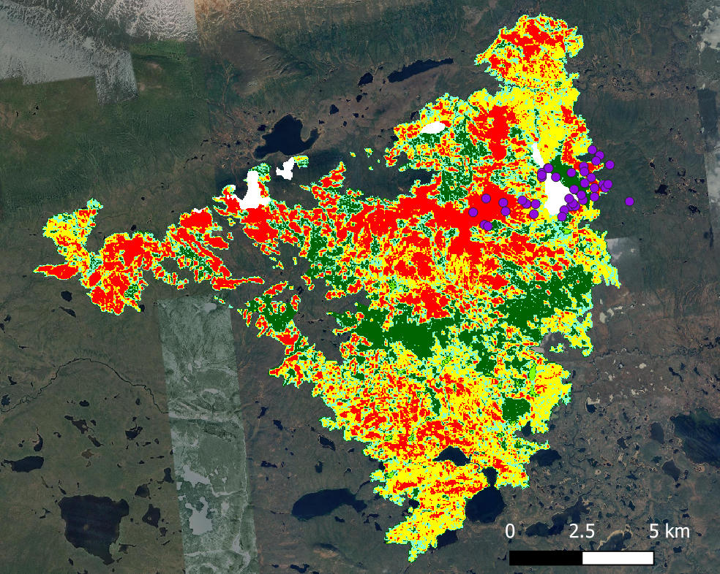

Slide 2
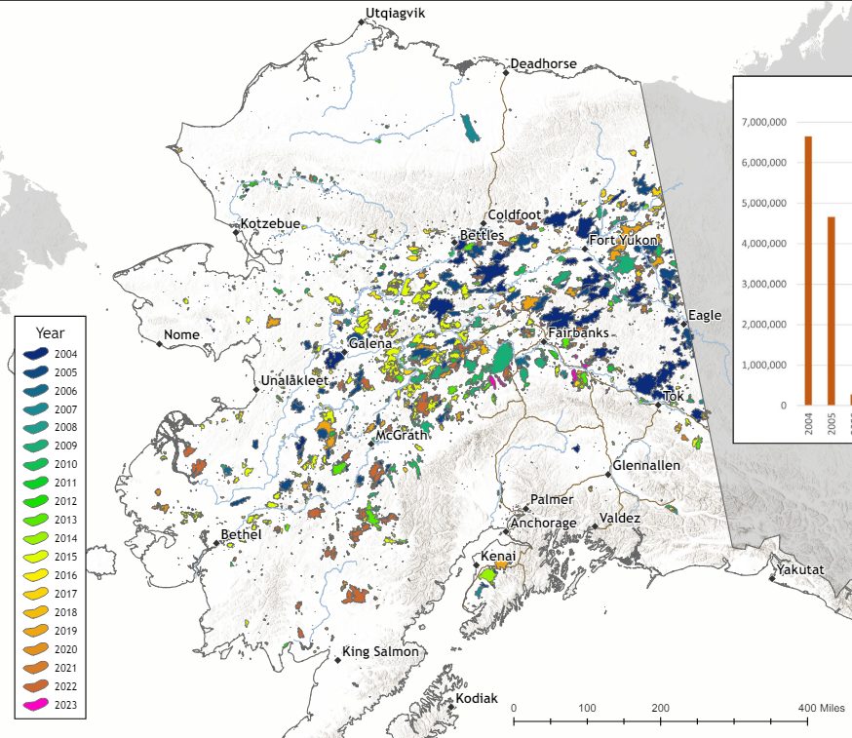
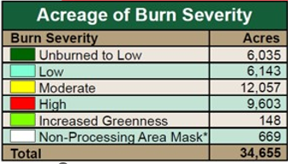

Slide 3
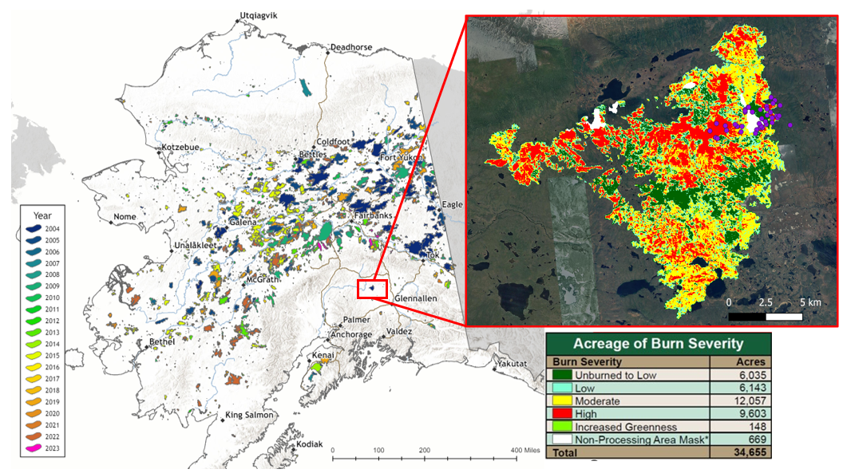

Slide 4
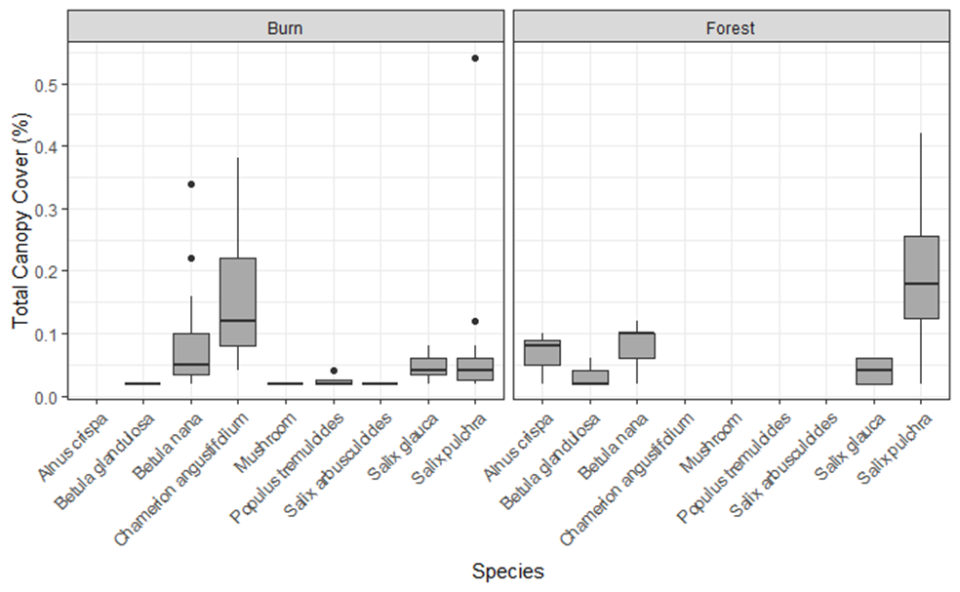
Total canopy cover (%)

Slide 5
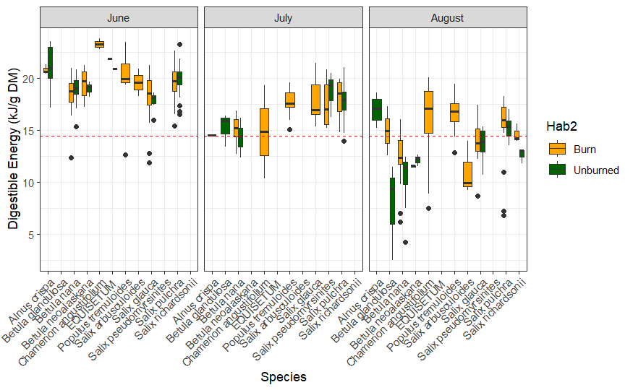
Burn/Unburned
Digestible energy (kJ g⁻¹ DM)

Slide 6
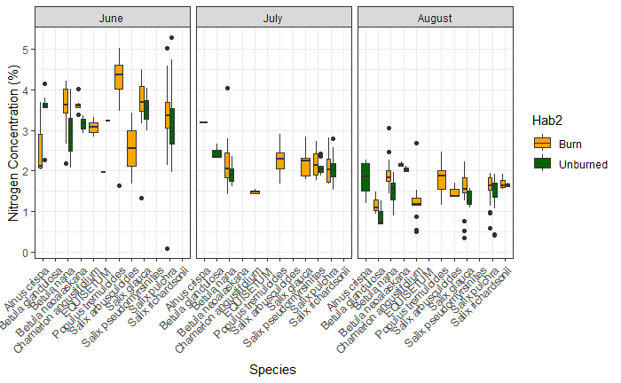
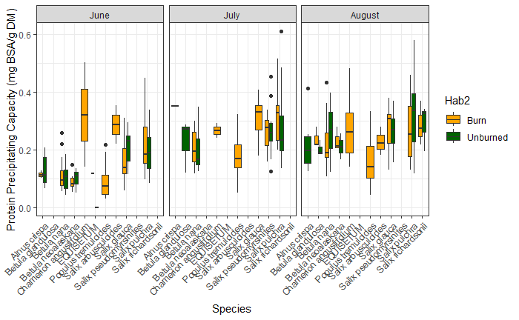
A
Burn/Unburned
Nitrogen concentration (%)
*
B
Burn/Unburned
Protein precipitating capacity
(mg BSA g⁻¹ DM)

Slide 7
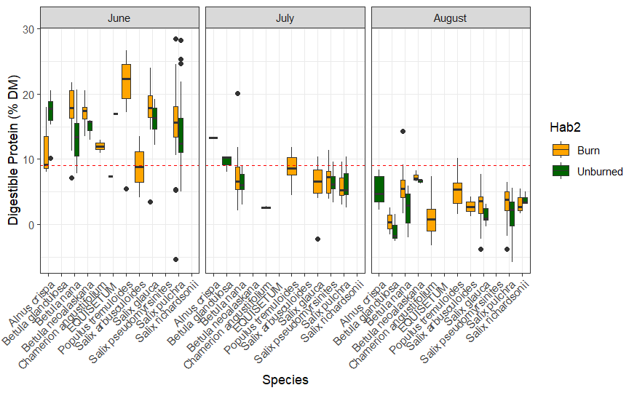
Burn/Unburned
Digestible protein (% DM)

Slide 8
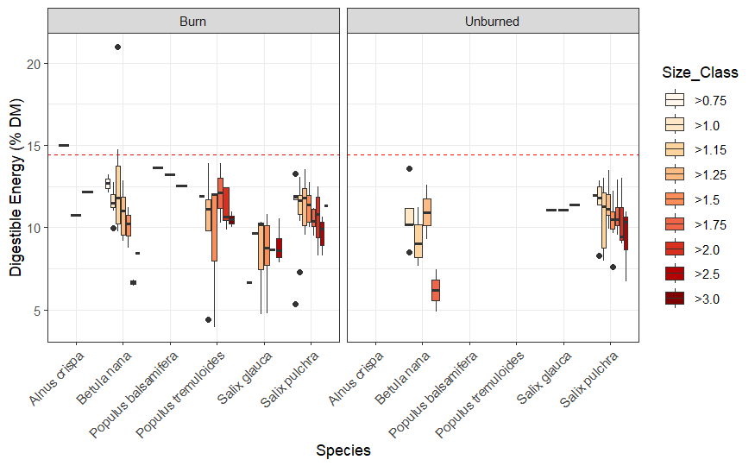
Digestible energy (kJ g⁻¹ DM)

Slide 9
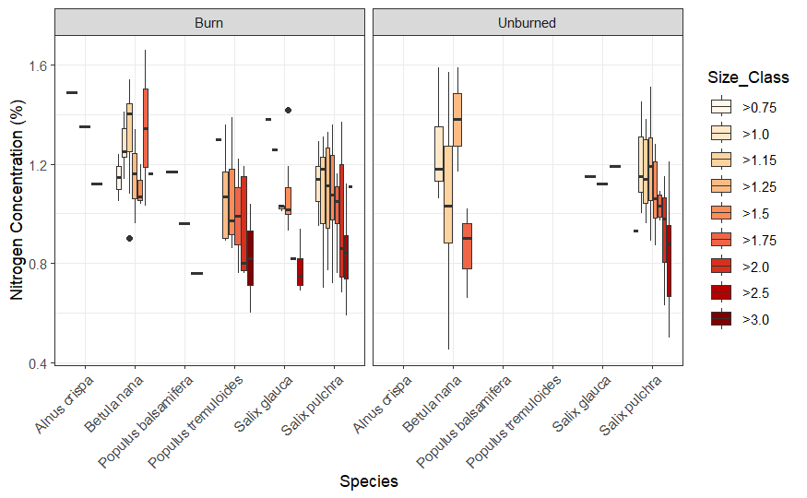
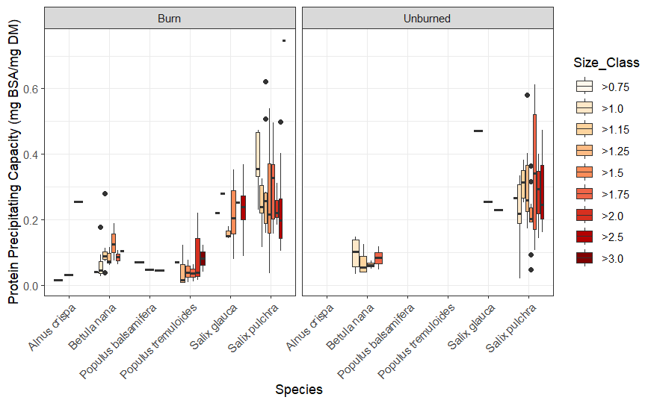
Nitrogen concentration (%)
*
Protein precipitating capacity
(mg BSA g⁻¹ DM)

Slide 10
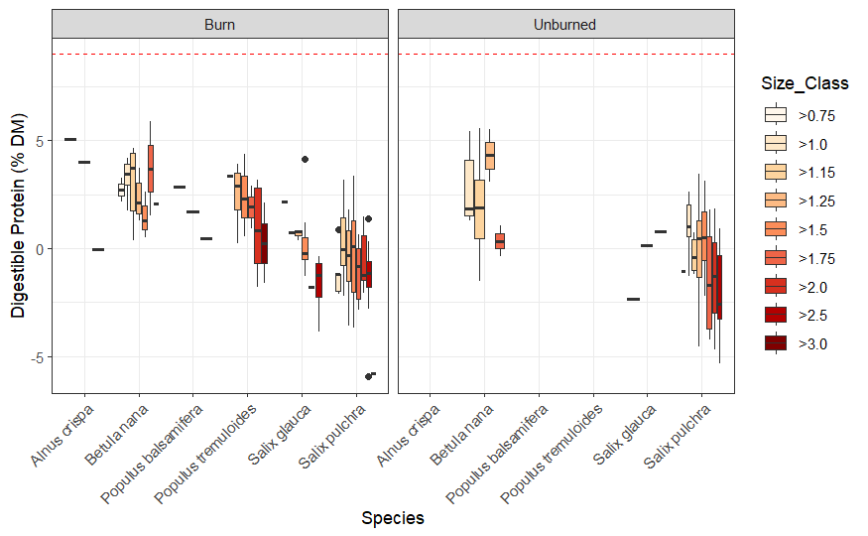
Digestible protein (% DM)

Slide 11
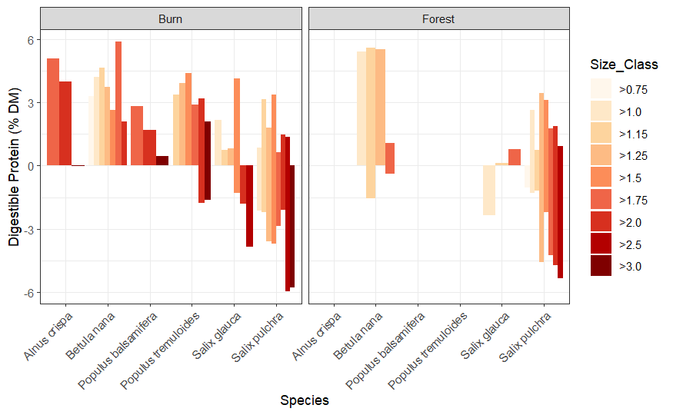

Slide 12
Table 2: Comparison of average digestible protein (% DM) of species appearing in both burned and unburned sites in the Alphabet Hills, Alaska in June, August, and March.
 | Mean (SE) | Diff | P-value | P-value |  | Mean (SE) | Diff |  | P-value
Alphabet Hills |  |  |  |  | Alphabet Hills
Burn | 6.96 (7.73) |  |  |  | June | 15.95 (5.11)
 |  |  |  |  | July | 6.78 (2.98) | 9.17
Forest | 6.71 (6.78) | 0.25 | 0.669 | 0.669 | August | 3.29 (3.13) | 3.49
 |  |  |  |  | March | 0.53 (2.34) | 2.76 | <0.0001***
S. pulchra |  |  |  |  | S. pulchra
Burn | 4.62 (7.52) |  |  |  | June | 14.57 (5.54)
 |  |  |  |  | July | 5.99 (2.22)
Forest | 5.48 (7.08) | -0.86 | 0.35 |  | August | 2.49 (2.99) | -0.126
 |  |  |  |  | March | -0.55 (2.03) | -0.031 | <0.0001***
B. nana |  |  |  |  | B. nana
Burn | 8.01 (6.56) |  |  |  | June | 15.25 (4.25)
 |  |  |  |  | July | 7.14 (3.74) | 8.11
Forest | 7.45 (5.90) | 0.56 | 0.65 | 0.65 | August | 4.65 (3.05) | 2.49
 |  |  |  |  | March | 2.63 (1.65) | 2.02 | <0.0001***
S. glauca |  |  |  |  | S. glauca
Burn | 8.01 (8.35) |  |  |  | June | 17.41 (3.64)
 |  |  |  |  | July | 6.07 (3.67) | 11.34
Forest | 6.88 (8.00) | 1.13 | 0.63 | 0.63 | August | 2.38 (2.83) | 3.69
 |  |  |  |  | March | -0.11 (1.67) | 2.49 | <0.0001***
Notes: DM is dry matter; Diff is the difference between the two sampling areas, and the two plant genera are Salix and Betula. Significant differences were determined with a paired t-test using a Bonferroni adjustment. Significant differences are denoted with asterisks. *p<0.05, **p<0.01, ***p<0.0001

Slide 13
Table 1: Comparison of average digestible energy (kJ/g DM) of species appearing in both burned and unburned sites in the Alphabet Hills, Alaska in June, August, and March
 | Mean (SE) | Diff | P-value | P-value |  | Mean (SE) | Diff |  | P-value
Alphabet Hills |  |  |  |  | Alphabet Hills
Burn | 14.90 (4.26) |  |  |  | June | 19.42 (5.11)
 |  |  |  |  | July | 17.00 (2.98) | 2.42
Forest | 15.38 (4.34) | -0.48 | 0.17 | 0.669 | August | 14.04 (3.13) | 2.96
 |  |  |  |  | March | 10.63 (2.34) | 3.41 | <0.0001***
S. pulchra |  |  |  |  | S. pulchra
Burn | 14.42 (4.27) |  |  |  | June | 19.79 (1.46)
 |  |  |  |  | July | 17.86 (1.73) | 1.93
Forest | 15.42 (4.27) | -1 | 0.065 |  | August | 15.16 (2.72) | 2.7
 |  |  |  |  | March | 10.80 (1.53) | 4.36 | <0.0001***
B. nana |  |  |  |  | B. nana
Burn | 13.86 (3.69) |  |  |  | June | 18.73 (1.53)
 |  |  |  |  | July | 14.66 (1.41) | 4.07
Forest | 14.33 (4.58) | -0.47 | 0.51 | 0.65 | August | 11.57 (2.58) | 3.09
 |  |  |  |  | March | 10.67 (2.57) | 0.9 | <0.0001***
S. glauca |  |  |  |  | S. glauca
Burn | 14.65 (8.35) |  |  |  | June | 18.11 (2.08)
 |  |  |  |  | July | 17.70 (2.18) | 0.41
Forest | 14.79 (8.00) | -0.14 | 0.88 | 0.63 | August | 13.93 (2) | 3.77
 |  |  |  |  | March | 8.96 (1.96) | 4.97 | <0.0001***
Notes: DM is dry matter; Diff is the difference between the two sampling areas, and the two plant genera are Salix and Betula. Significant differences were determined with a paired t-test using a Bonferroni adjustment. Significant differences are denoted with asterisks. *p<0.05, **p<0.01, ***p<0.0001

Slide 14
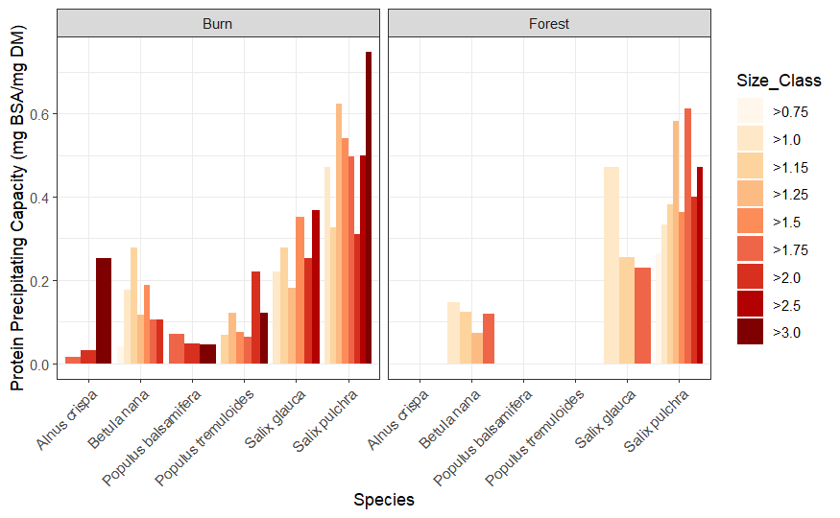

Slide 15
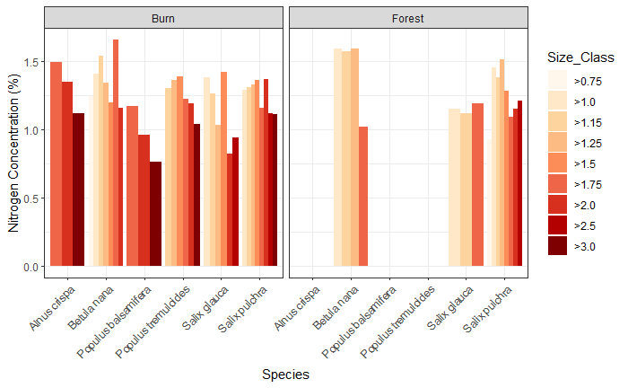
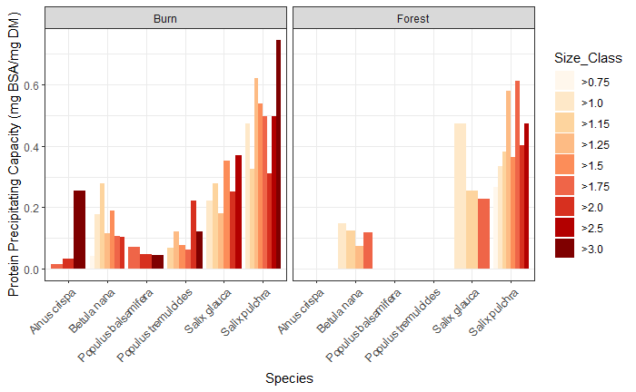
A
*
B

